Slide 1

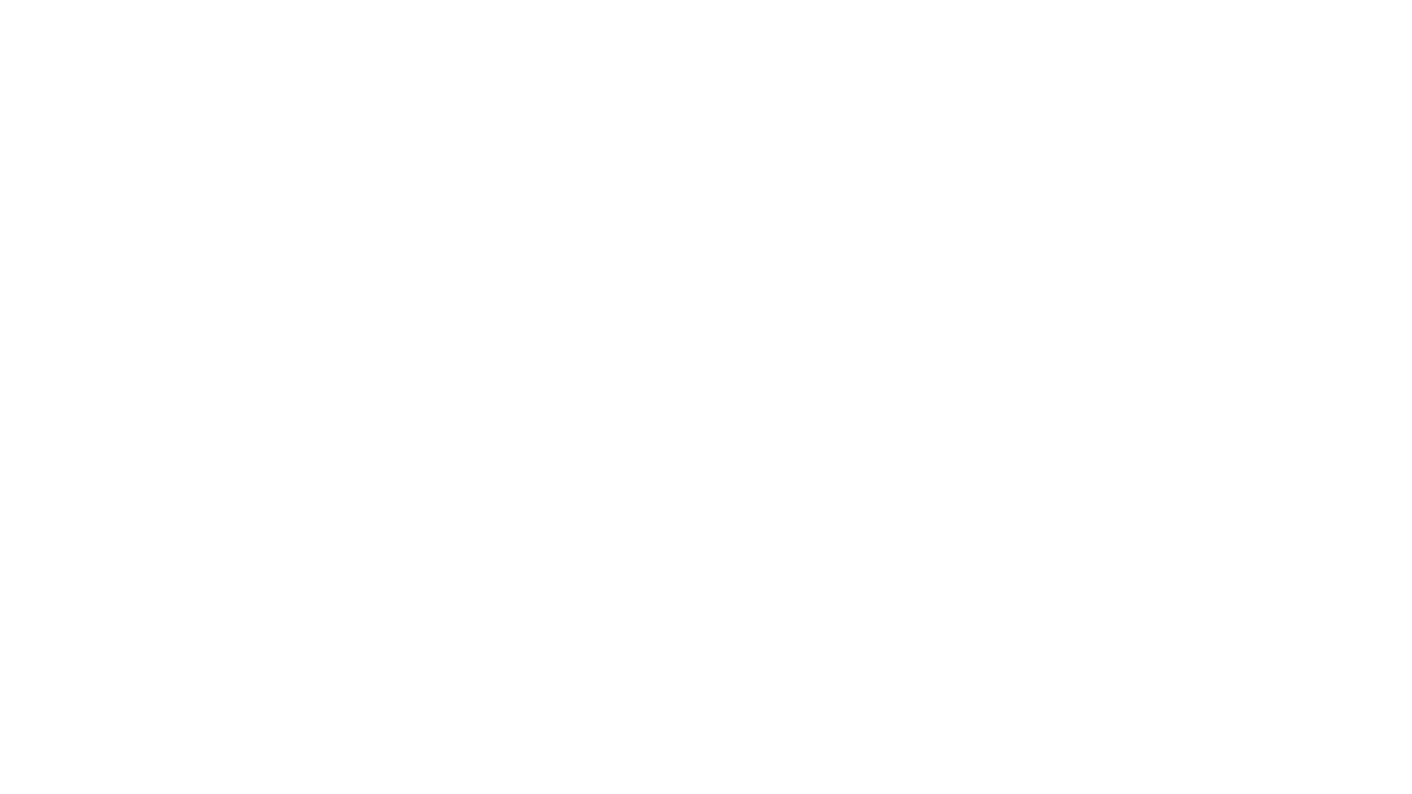

AI and machine learning CA1
By shaun kwo rui yu
P2317933
DAAA/FT/1B/06

Slide 2
Step 1: Exploratory data analysis

Slide 3
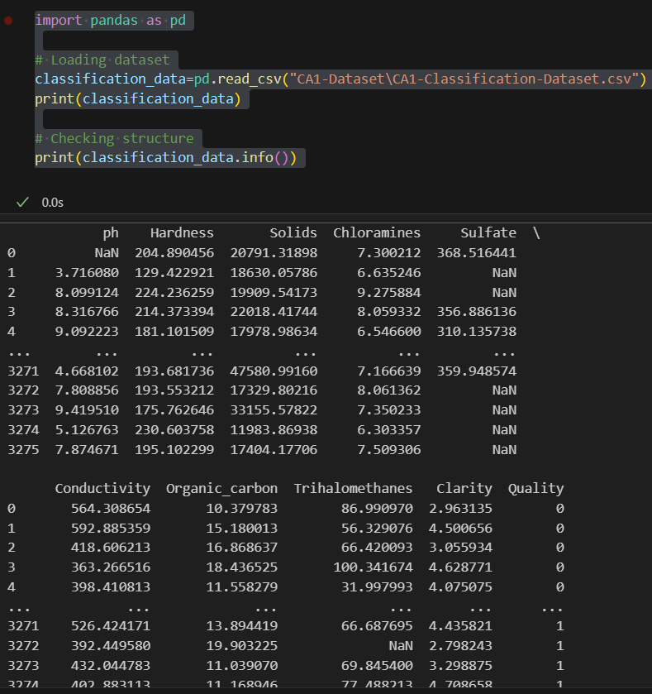
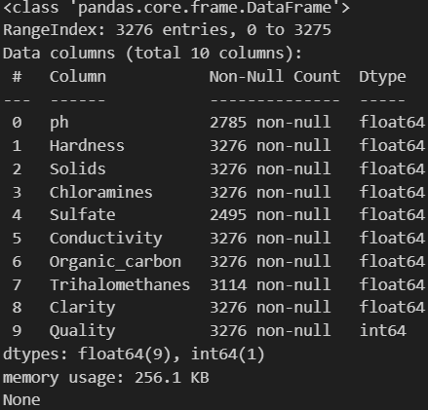
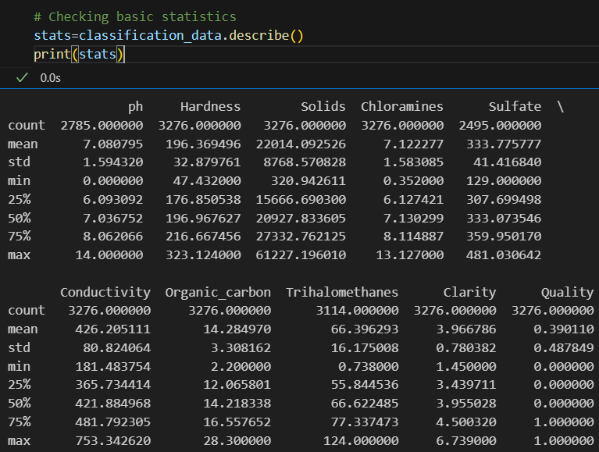
Classification dataset 1.1 Data overview for PREDicting water quality
Loading dataset for the classification in the classification.ipynb as classification_data
There are missing valus in ph, sulfate and trihalomethanes
Further statistical analysis can be done using the .describe method as it shows for example mean, standard dev, and maximum value
=> max can be used to check if there is any anomalies

Slide 4
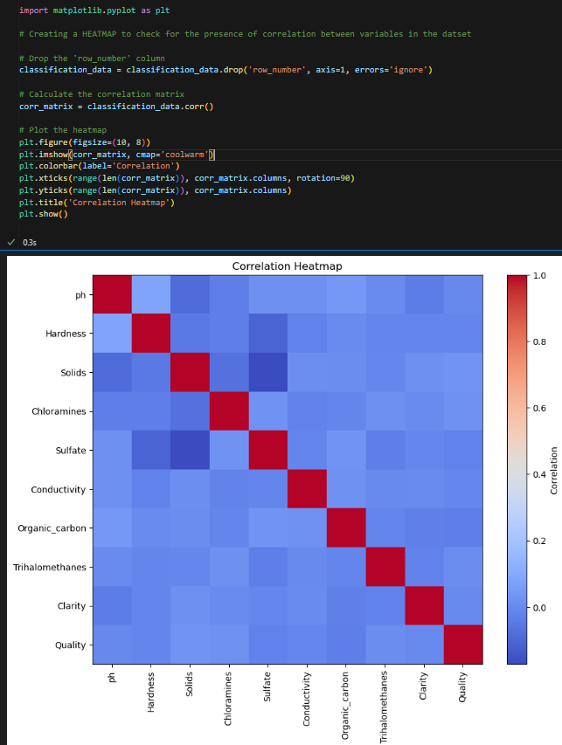
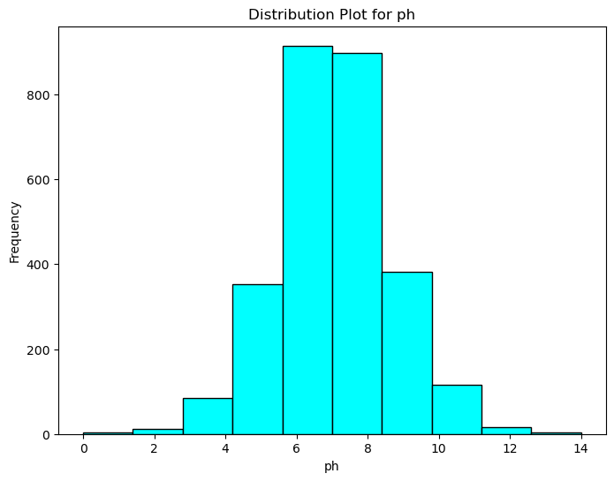
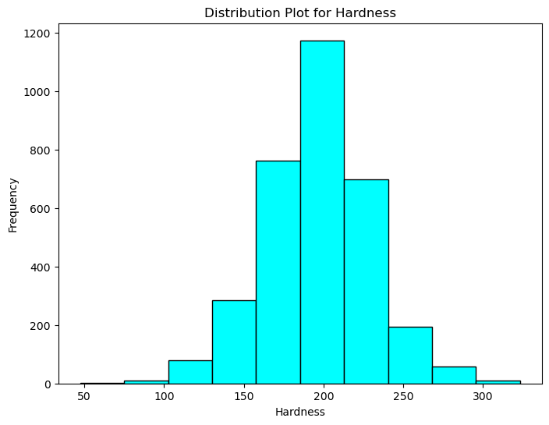
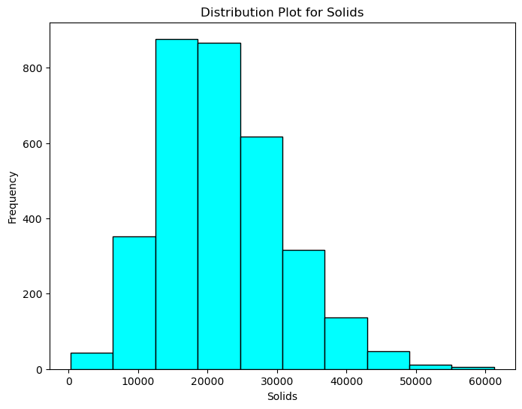
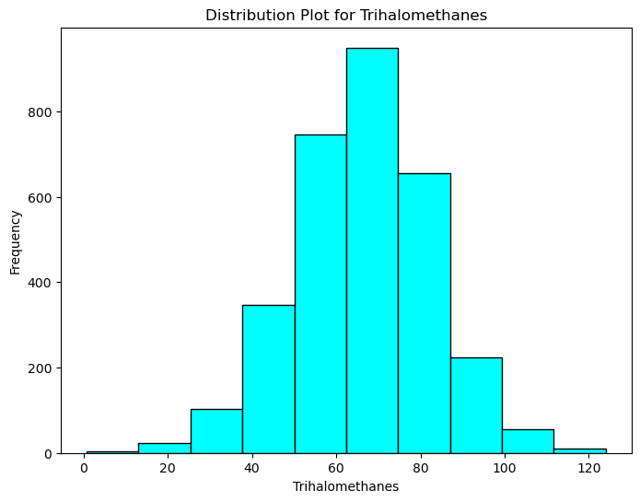
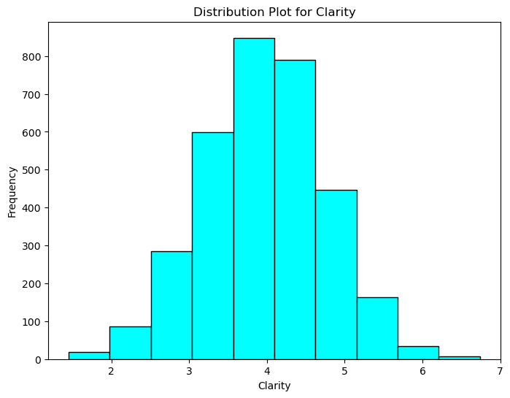
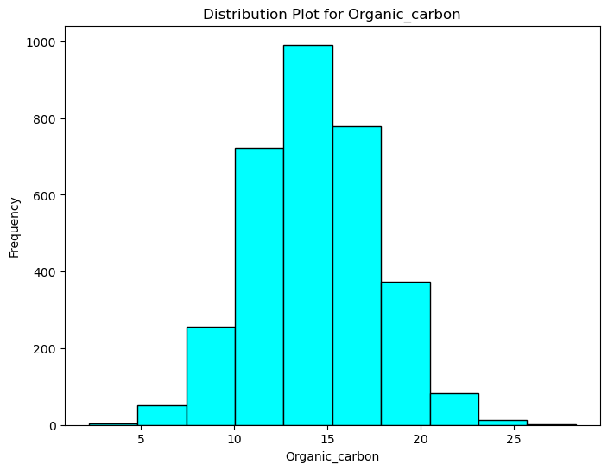
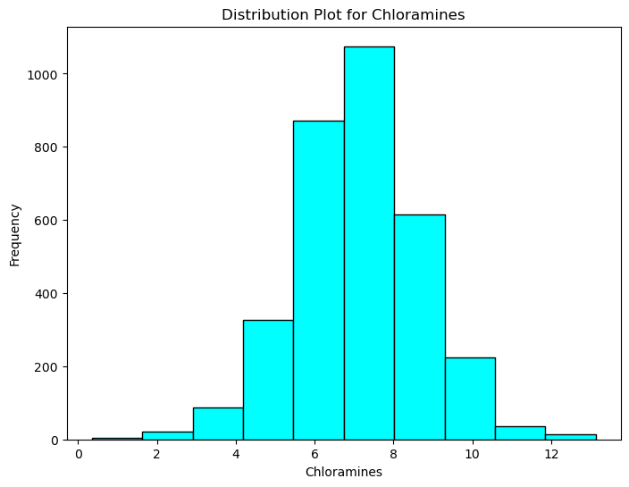
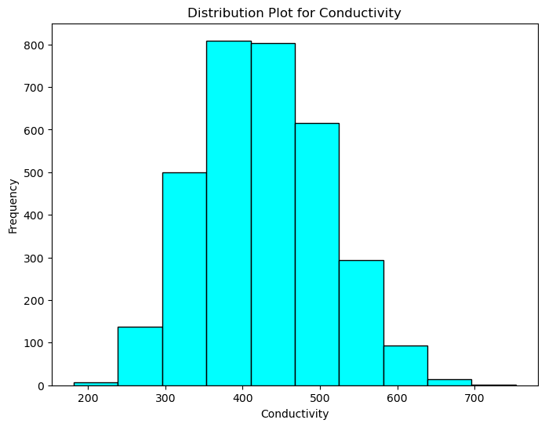
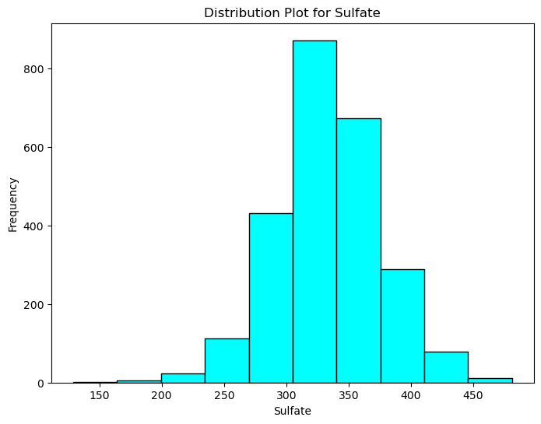
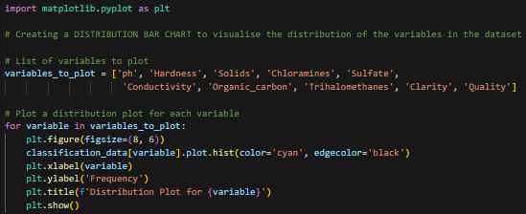
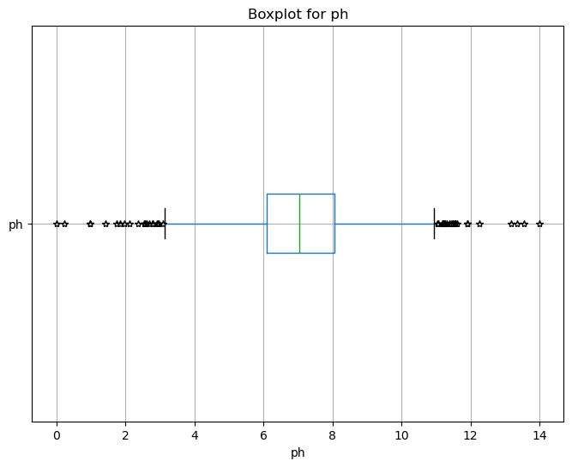
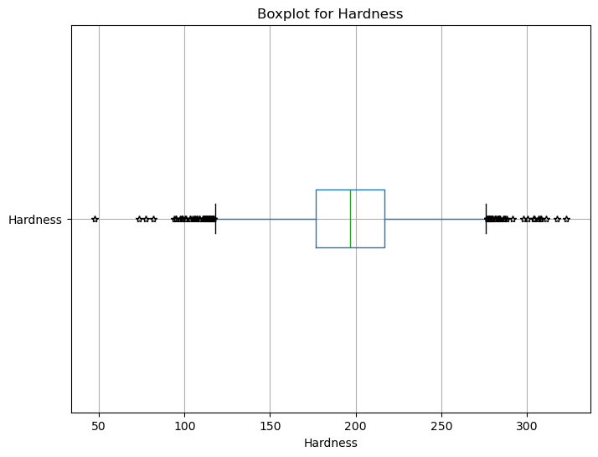
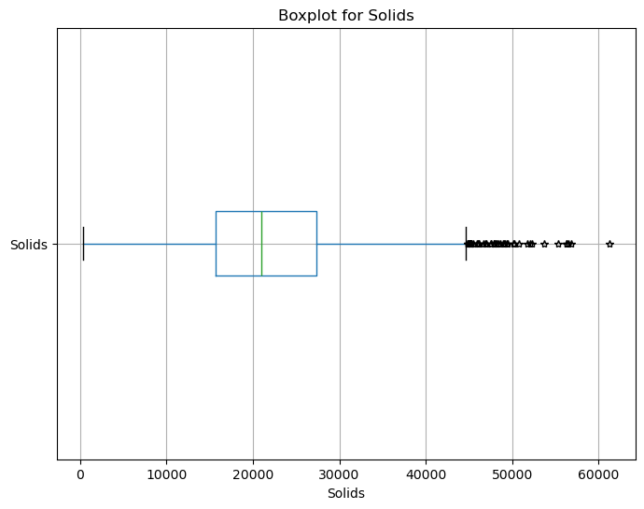
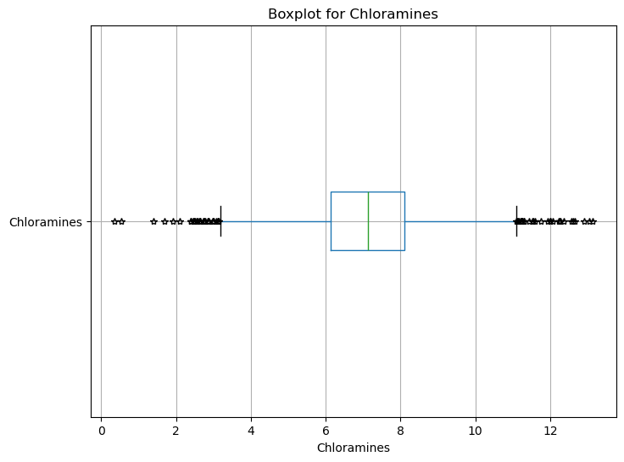
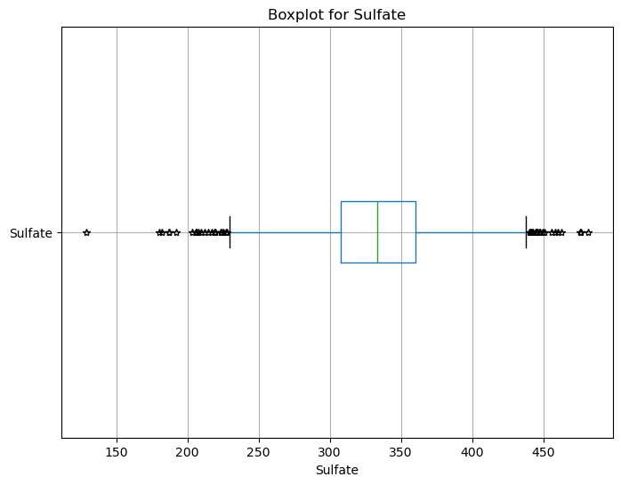
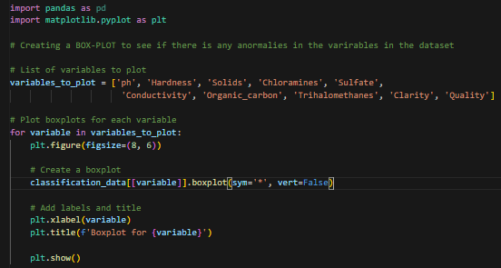
1.2 Feature analysis and Data visualisation
1.) Creating a heatmap to check if there is any correlation between any of the variables as highly correlated features would not contribute to improving model performance and may even negatively impact model performance.
2.) Checking which variable in what region has the highest frequency using a histogram. Interesting to note that the tails of the normal distribution graph also shows anomalies.
credit to https://www.youtube.com/watch?v=lTc7NU9XpWE&ab_channel=NazimUddin
3.) Boxplot is to find the anomalies in the dataset
and more boxplots…
Credit to https://www.youtube.com/watch?v=UgtjatBt3vY&ab_channel=RyanNoonan to teach me create this correlation heatmap

Slide 5
How the Prediction Task is Defined:
The task is to build machine learning models to predict water quality based on various water properties such as ['ph', 'Hardness', 'Solids', 'Chloramines', 'Sulfate, 'Conductivity', 'Organic_carbon', 'Trihalomethanes', 'Clarity’]
Meaning of the Output Variable:
The output variable, "quality," represents the classification of the water samples. Quality is binary and ‘1’ most likely being clean and ‘0’ being dirty so the models have to use the other various water properties such as ['ph', 'Hardness', 'Solids', 'Chloramines', 'Sulfate, 'Conductivity', 'Organic_carbon', 'Trihalomethanes', 'Clarity’] to predict if quality is ‘1’ =safe to drink or ‘0’ = unsafe to drink

Slide 6
Step 2: DATA PREProcessing/Feature engineering
.

Slide 7
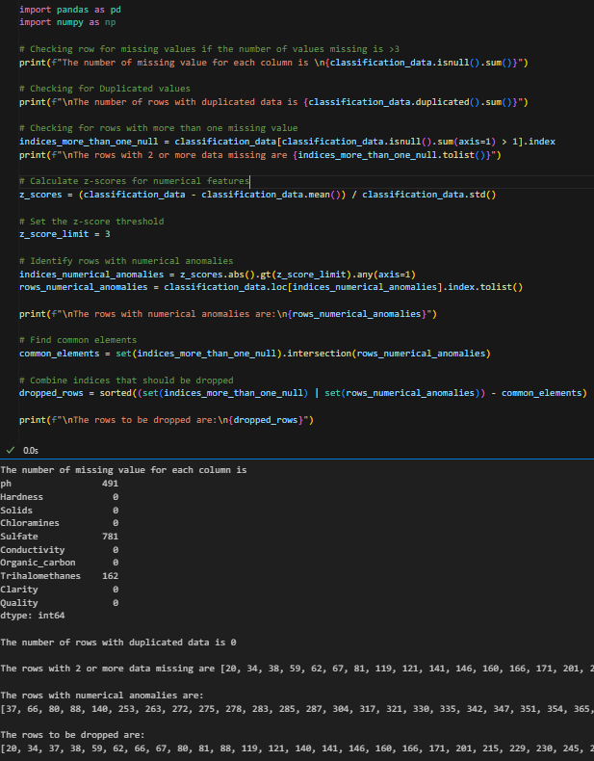
Did you process the features in any way?
2.1 Identifying missing values and anomalies
CHECKING FOR MISSING VALUES
.isnull() checks if there is any missing values in each of the columns and .sum() would sum it up giving the total number of missing values in each variable column.
CHECKING FOR DUPLICATED ROWS
.duplicate check if there is rows that are exactly the same and .sum would sum up the rows.
USING ZSCORE TO CHECK FOR ANOMALIES (Zscore= (x-μ)/s.d. )
encooperated z-score from Business Statisitics to be able to find numerical anomalies in each column. indices_numerical_anomalies = z_scores.abs().gt(z_score_limit).any(axis=1). gt() is an element-wise comparison, checking if each element of the DataFrame is greater than a specified value -> this line of code is done by ChatGPT.
Then I dropped the rows that had more than 1 missing values or had any anomalies
COMBINING THE ROWS THAT HAVE MISSING VALUES AND ANOMALIES TO DROP
As the number of rows dropped is less than 10% (<300) rows, it would have some but insufficient impact on the models, hence they can be dropped

Slide 8
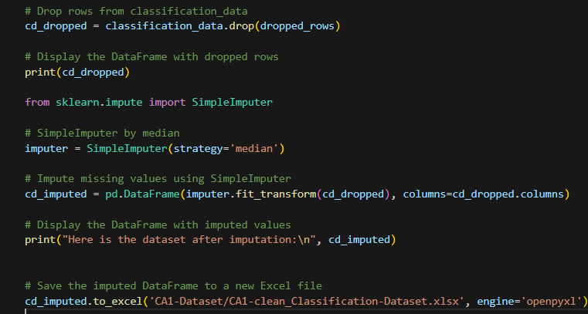
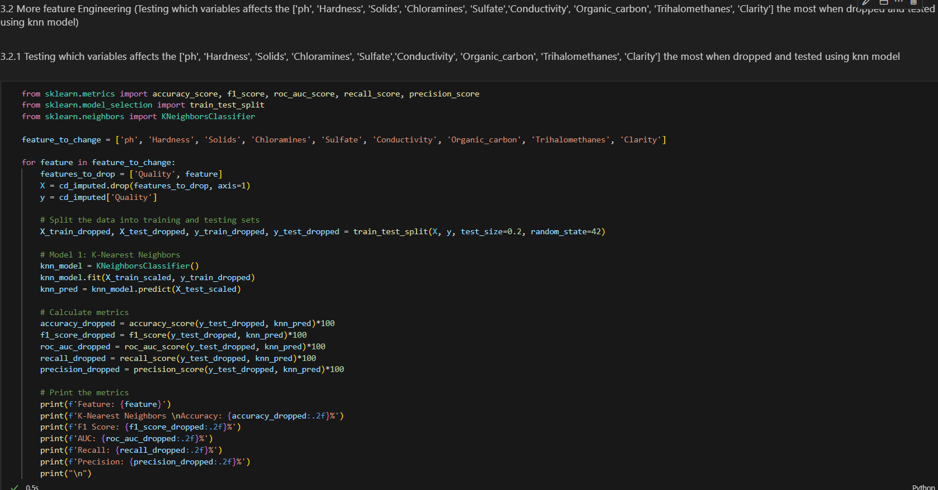
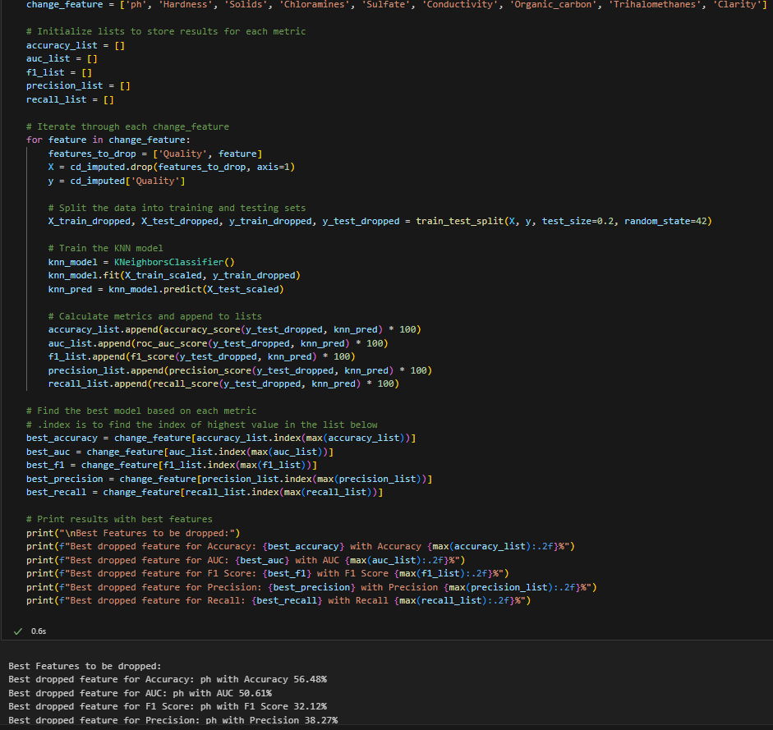
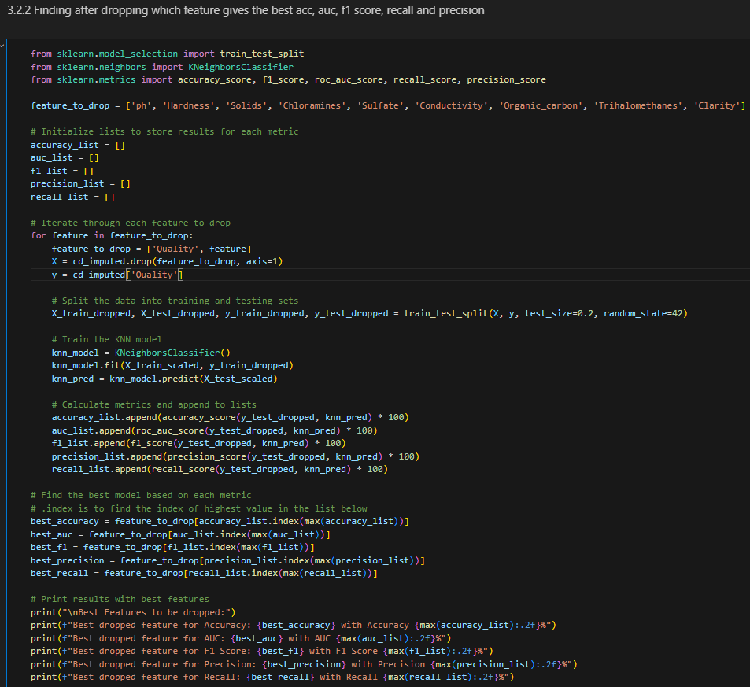
2.2 Dropping rows and imputing
After combining the rows with more than 1 missing value and anomalies, I dropped these rows
USING SIMPLEIMPUTER (MEDIAN)
I used median as the median is less sensitive to extreme values compared to the mean and by imputing, I would fill up the rows with one missing value
SAVING THE IMPUTED DATA INTO A .XLSX FILE
This is for me to check if the values have actually been imputed as python only prints the top and bottom of the dataset and is not a good confirmation if data is imputed.
FINDING DROPPING WHICH COLUMN WOULD GIVE THE BEST ACC, AUC, F1, RECALL AND PRECISION using KNN to test
In conclusion it was ph, after setting a random state and assuming all other models would be the same as results of the KNN model.
However, since I put it as random state, it would give an inaccurate estimate to which feature to drop but when I remove random state the feature to drop always changes so, I have decided to not drop ph
As there is no non-numerical data, one-hot encoding is not needed.

Slide 9
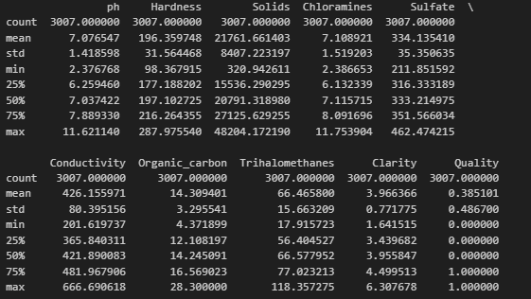
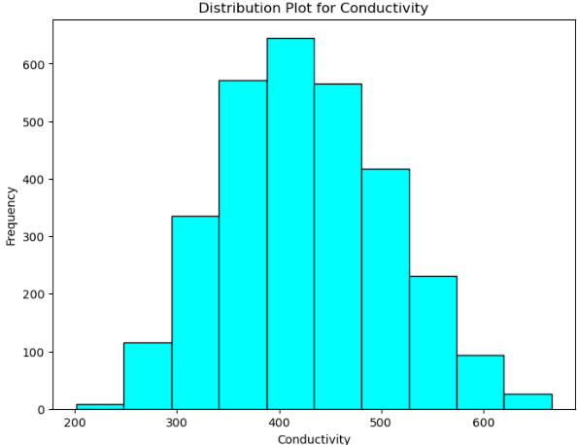
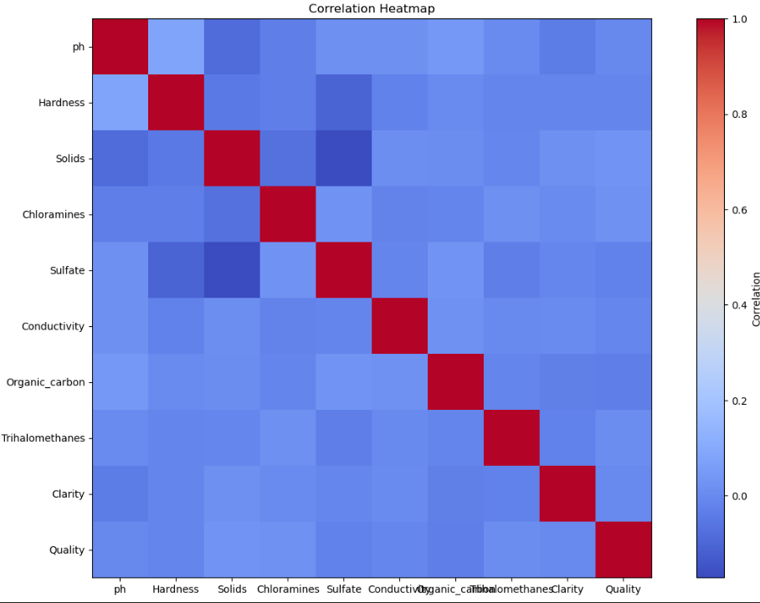
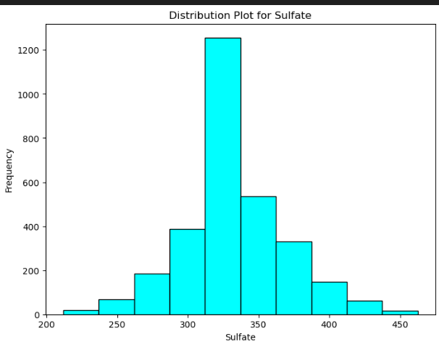
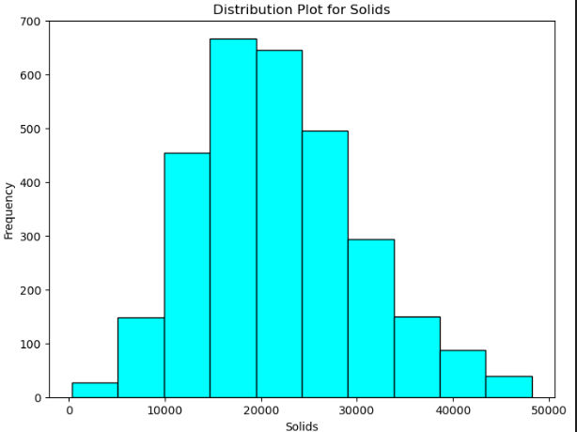
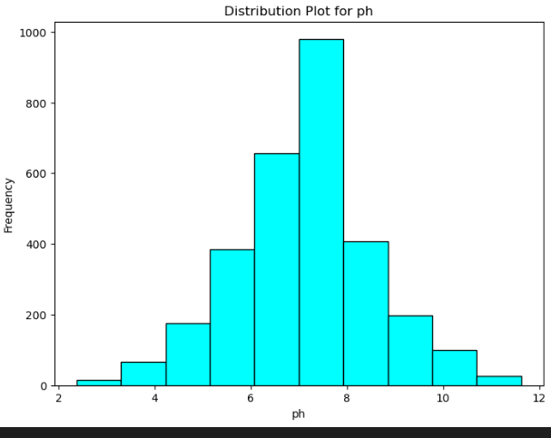
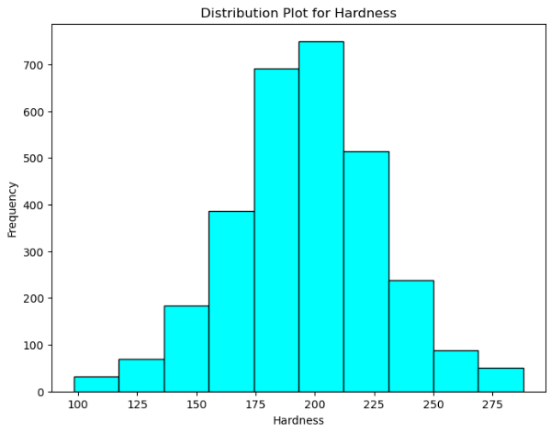
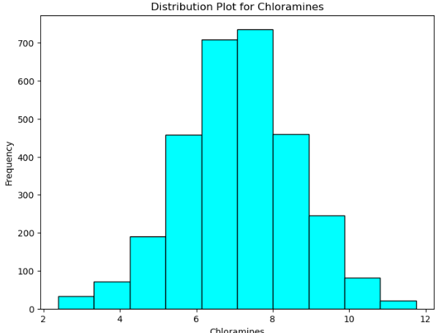
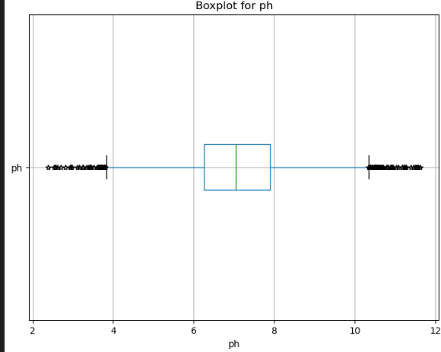
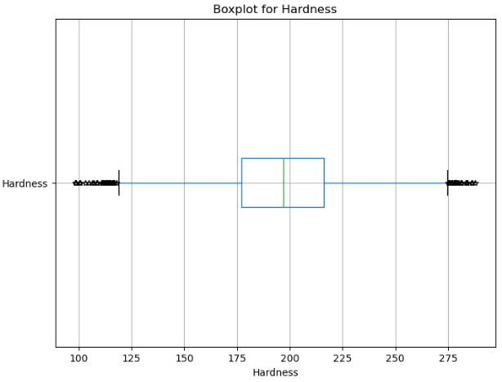
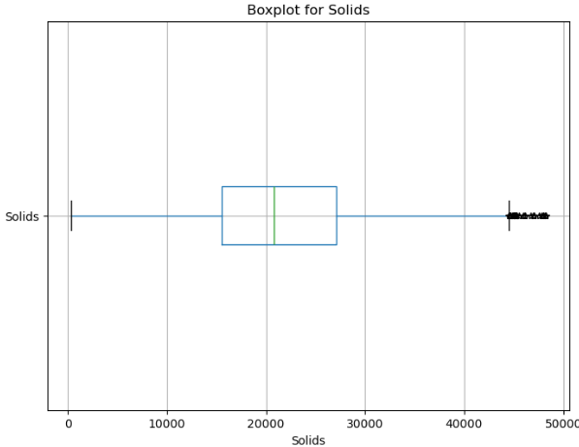
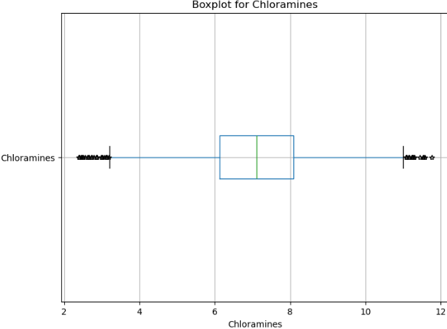
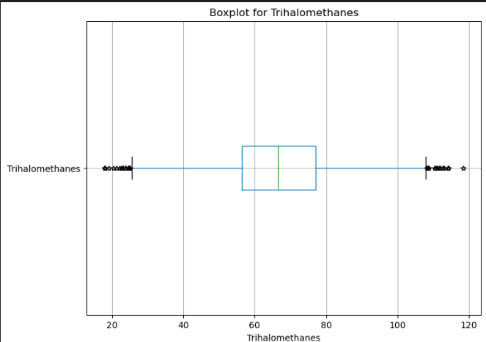
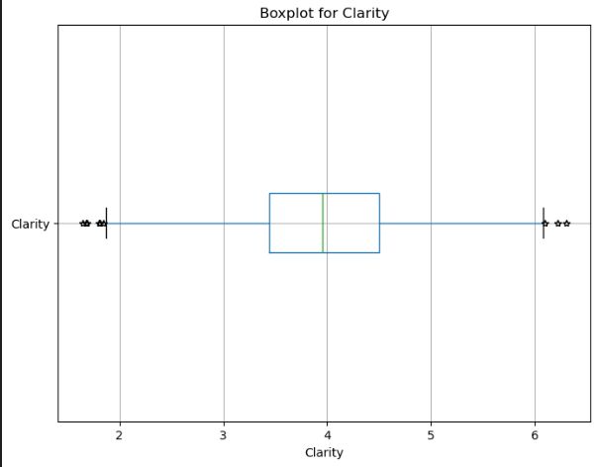
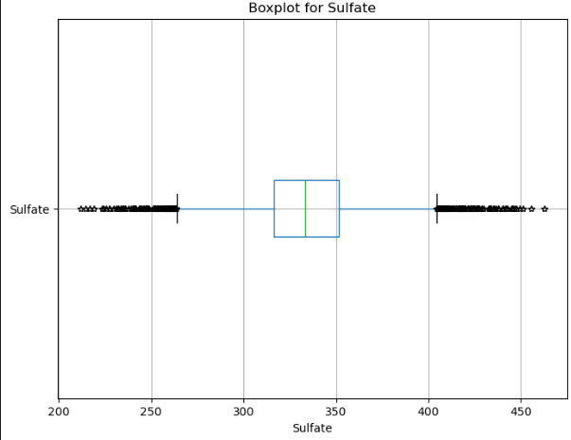
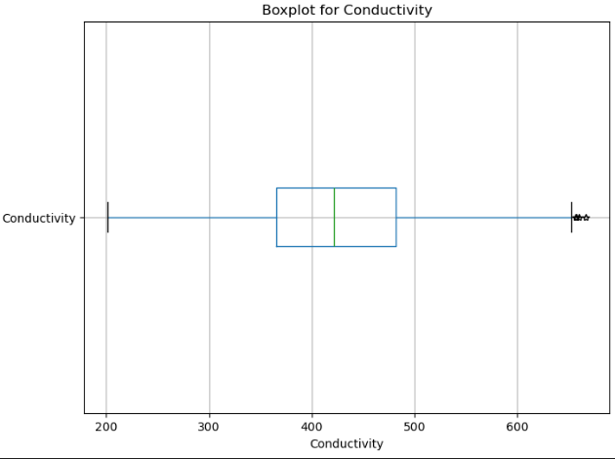
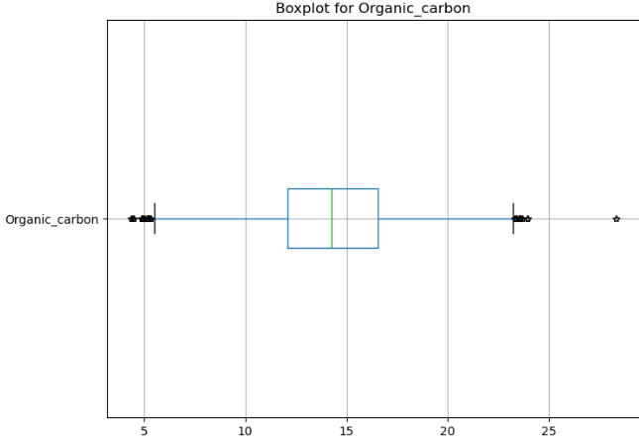
2.3 Data visualization after imputing

Slide 10
Step 3: MODEl selection

Slide 11
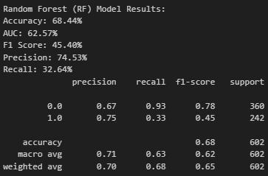
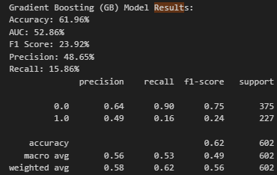
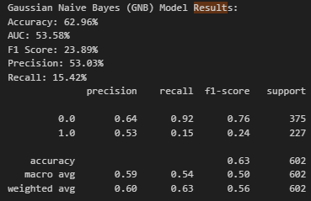
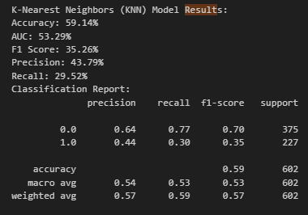
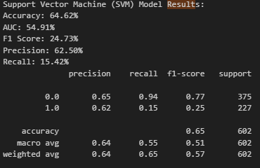
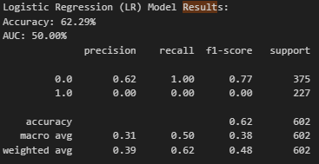
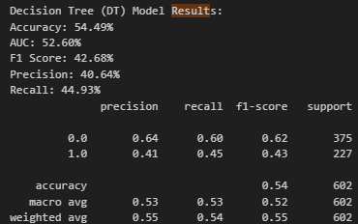

3.1 Getting all possible classification models
I tried using knn, svm, naïve bayes, logistic regression, decision tree, random forest and gradient boosting
3.2 How did you select which learning algorithms to use?
After finding the accuracy, AUC, F1, Precision and recall of each model, I used the code on the left to find the best 4 learning models to do hyperparameter tuning which are Decision tree, gradient boosting, random forest and svm.

Slide 12
Step 4 : Hyperparameter tuning for the top 4 models and model evaluation

Slide 13


4.1 Did you try to tune the hyperparameters of the learning algorithm, and in that case how?
Max-depth-> controls the max depth of each decision tree
Min-sample leaf-> min number of samples required at the end of each leaf (end of branch)
Min-sample-split-> min number of samples required for each splitting of the branches
N-estimator-> number of trees in ensemble (random forest)
Learning rate->small learning rate means model is adjusting slowly and help avoid big mistakes, taking a longer time to reach an optimal solution
Subsample-> picking part of a sample to help add randomness to the data
Bootstrap-> using true or false to build the tree
The below is from chatgpt
C-> controls trade off between smooth decision boundaries and classifying the training data correctly
Kernel-> the type of kernel function used for the svm such as linear, polynomial, radial basis function
Gamma-> kernel coefficient for RBF, poly and sigmid
Degree-> degree of the polynomial kernel function
DECISION TREE
Normal hyperparameters are *, criterion='gini', splitter='best', max_depth=None, min_samples_split=2, min_samples_leaf=1, min_weight_fraction_leaf=0.0, max_features=None, random_state=None, max_leaf_nodes=None, min_impurity_decrease=0.0, class_weight=None, ccp_alpha=0.0
My hyperparameters are

Slide 14


GRADIENT BOOSTiNG
Normal hyperparameters are *, loss='log_loss', learning_rate=0.1, n_estimators=100, subsample=1.0, criterion='friedman_mse', min_samples_split=2, min_samples_leaf=1, min_weight_fraction_leaf=0.0, max_depth=3, min_impurity_decrease=0.0, init=None, random_state=None, max_features=None, verbose=0, max_leaf_nodes=None, warm_start=False, validation_fraction=0.1, n_iter_no_change=None, tol=0.0001, ccp_alpha=0.0
Best hyperparameters are

Slide 15


RANDOM FOREST
Normal hyperparameters are n_estimators=100, *, criterion='gini', max_depth=None, min_samples_split=2, min_samples_leaf=1, min_weight_fraction_leaf=0.0, max_features='sqrt', max_leaf_nodes=None, min_impurity_decrease=0.0, bootstrap=True, oob_score=False, n_jobs=None, random_state=None, verbose=0, warm_start=False, class_weight=None, ccp_alpha=0.0, max_samples=None
Best hyperparameters are

Slide 16


Support vector machine
Normal hyperparameters are *, C=1.0, kernel='rbf', degree=3, gamma='scale', coef0=0.0, shrinking=True, probability=False, tol=0.001, cache_size=200, class_weight=None, verbose=False, max_iter=1, decision_function_shape=‘ovr', break_ties=False, random_state=None
Best hyperparameters are

Slide 17

WHICH MODEL IS THE BEST?
As using the classification metrics which are accuracy, AUC, F1 score, Precision and Recall, support vector machine (SVM), the highest accuracy of 70.1% and highest AUC of 63.27%, the highest F1 score of 46.11%, highest precison score of 76.24% and highest recall of 33.05%

Slide 18

DUMMY BASELINE MODEL
As using the classification metrics which are accuracy, AUC, F1 score, Precision and Recall, the dummy model has an accuracy of 61.6% and AUC of 50.0%
The reason dummy models don't have F1 score, precision, or recall is that these metrics are calculated based on the true positive, true negative, false positive, and false negative values, which are specific to a binary classification problem. The dummy classifiers, by design, do not make meaningful predictions and do not produce a confusion matrix with these values.

Slide 19


HOW DOES MY DUMMY MODEL COMPARE WITH my best CLASSIFICATion model?
Better accuracy->better overall classification performance of SVM compared to Dummy
More Area Under Curve
Better F1 score-> better balance between precision and recall of the SVM as compared to the Dummy
SVM has more correctly predicted positive results to total positives than the Dummy
SVM has more correctly predicted positive results to total results than the Dummy

Slide 20

FEATURE IMPORTANCE
Sulfate and ph are considered very important by the model while features like Organic_carbon and Clarity are not very useful to the model

Slide 21
Predicting Hospital cost ($) Regression

Slide 22
Step 1: EDA

Slide 23


1.1 DATA overview for Predicting hospital cost
Loading the regression dataset
There is 0 null values in the dataset
All features are numerical except for gender, region and smoker(which is actually binary)

Slide 24



1.2 DATA visualization
From these diagram, you can see that most people who go to the hospitals as in their 20s and have a BMI of about 30.
Also there is a minority of non-smokers
The scatter-plot also shows that as age increases, the hospital cost also increases.
The boxplot shows that the median age of people going to the hospital is 40 and with an median BMI of about 30 and median cost is about $10k but cost can go as high as $65k+

Slide 25

How the Prediction Task is Defined:
The task is to build machine learning regression models to predict hospital cost($) based on different variables such as [Age, Gender, BMI, Smoker, region]. Meaning of the Output Variable:
The output variable, “Cost ($)" represents the regression of the patient information. so the models have to use the patient information such as [Age, Gender, BMI, Smoker, region] to predict the numerical estimated cost of the hospital bill
The heatmap also shows that there is a strong correlation between age and smoker with cost

Slide 26
Step 2: data preprocessing/FEATURE ENGINEERiNG

Slide 27


2.1 Checking for missing data and anomalies 2.2 Creating new file
There is no rows with missing data but there are many rows with anomalies such 34,39,55,96,94 and so on..
Then dropping rows with anomalies

Slide 28

2.3 one-hot encoding
The purpose of one hot encoding is to make non-numeric values to be converted to numeric or binary values so that the regression model would be able to learn faster and give more accurate results

Slide 29

2.4 Feature engineering (in code its in the model selection area as x &y are needed)
Even though I have already set a random state, the best feature to be dropped still keeps on changing so dropping any feature might result in the loss of valuable information for building the other models

Slide 30
Step 3: Model selection

Slide 31


3.1 defining x&y and 3.2 train-test Split and 3.3 scaling
3.4 Finding which column to drop to decrease RMSE and MAPE of the models by testing using Decision Tree Regressor
Use train-test-split to split the datapoints
Use a 80-20 ratio for training to testing data

Slide 32


3.4 Finding the best models to be hyperparameter tuned
I would be using MAPE and RMSE to determine which model will be selected to do hyperparameter tuning
The lower the MAPE and RMSE, the better the regression model it is.

Slide 33

3.5 Best Performing Models to do hyperparameter tuning
I have also realized that as MAPE increases, RMSE increases and as MAPE decreases, RMSE also decreases

Slide 34




4 hyperparameter tuning
4.1 Using the best 3 model from before GridSearchCV is used to do hyperparameter tuning.
There is 3 cross-fold validation for each model
The best parameters for
Random Forest (with hyperparameter tuning) Best Parameters: {'max_depth': 5, 'min_samples_split': 10, 'n_estimators': 150}
KNN (with hyperparameter tuning) Best Parameters: {'algorithm': 'auto', 'n_neighbors': 7, 'weights': 'distance’}
Gradient Boosting (with hyperparameter tuning) Best Parameters: {'learning_rate': 0.1, 'max_depth': 3, 'n_estimators': 50}

Slide 35

4.2 The best model after hyperparameter tuning
In conclusion, the best regression model for predicting hospital cost($) is Gradient Boosting (with hyperparameter tuning) Best Parameters: {'learning_rate': 0.1, 'max_depth': 3, 'n_estimators': 50}

Slide 36

5 Dummy baseline model
MAPE of 167.18% indicates a large average percentage error between the predicted and actual values.
RMSE of 11762.80 suggests that, on average, the squared differences between the predicted and actual values are quite large

Slide 37


HOW DOES MY DUMMY MODEL COMPARE WITH my best regression model?
Lower MAPE-> more accurate predictions for my GRADIENT BOOSTING MODEL as a percentage than the dummy model
Lower RMSE-> GRADIENT BOOSTING MODEL's predictions have smaller errors on average. This suggests that the model is better at minimizing the differences between predicted and actual values as compared to the dummy model

Slide 38

FEATURE IMPORTAnce oF the gradient boosting regression model
The 2 most important features deemed by the model is Smoker and Age
The least important features are gender and Region_southeast

Slide 39
What have I learnt from the assignment?
IN CONCLUSION FROM CLASSIFICATION AND REGRESSION PROJECTS, I UNDERSTOOD HOW TO :
Data Handling:
Managed data preprocessing, handling missing values, encoding, and feature scaling.
Modeling and Tuning:
Utilized scikit-learn for model building, experimenting with algorithms and hyperparameters.
Evaluation Skills:
Assessed model quality using metrics like accuracy, RMSE, and MAPE.
Compared models against dummy baselines for benchmarking.
Analysis and Interpretability:
Conducted a detailed analysis of tasks and output variable meanings.
Explored feature importance, understanding which features impact predictions.

Slide 40
Thank You FOR TEACHING ME AI AND machine learning it is so much funnnnnn sorry for making it so longwinded

